Slide 1
IT 4883: Infrastructure Defense
Risk Management

Slide 2
Goals in Risk Management
Ensure our assets are safe
Protect our assets against competitive disadvantage
Maintain a good public reputation

Slide 3
Risk Management Steps
Identify Risk
Assess Risk
Control Risk

Slide 4
Risk Management
Identification, measurement, control and minimization of security risks in information systems to a level commensurate with the value of the assets protected (NIST).
Identify
the
Risk Areas
Re-evaluate
the Risks
Assess the
Risks
Risk Management
Cycle
Implement Risk
Management
Actions
Risk Assessment
Develop Risk
Management
Plan
Risk Control (Mitigation)

Slide 5
Risk Identification
Asset | Asset Function | Asset Type and Subcategory | Priority Level
Server | Database Server | Hardware: Networking | High
Users Personally Identifiable Information | Provide information for all org transactions | Data: Confidential Information | Critical
Software | Employee access to enterprise software | Software: Operating System | Medium
The steps to risk identification are:
  Identify your org’s information assets
  Classify assets
  Rank assets

Slide 6
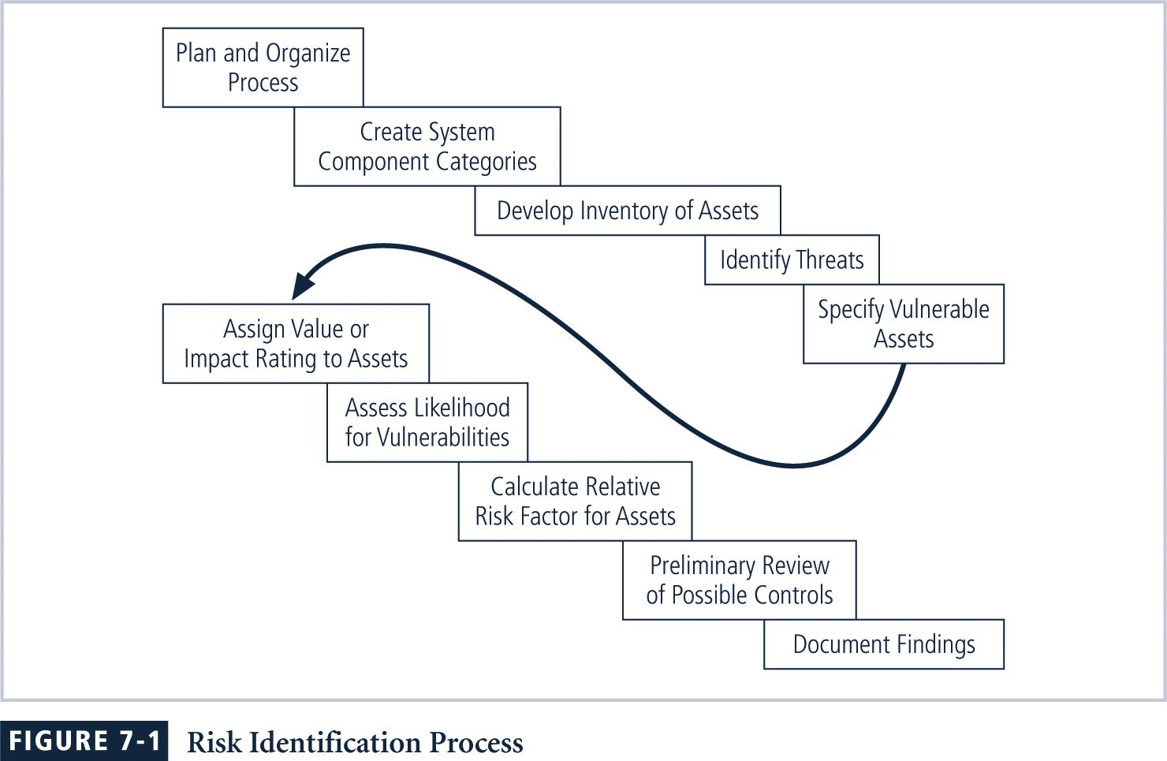
Risk Identification Process

Slide 7
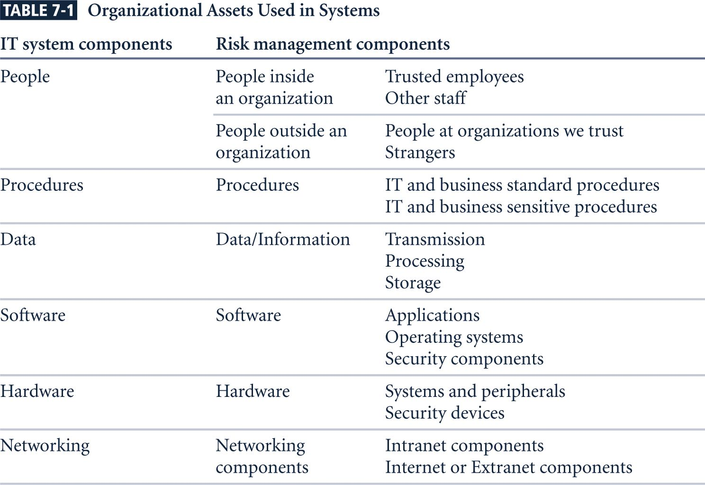
Organizational Assets

Slide 8
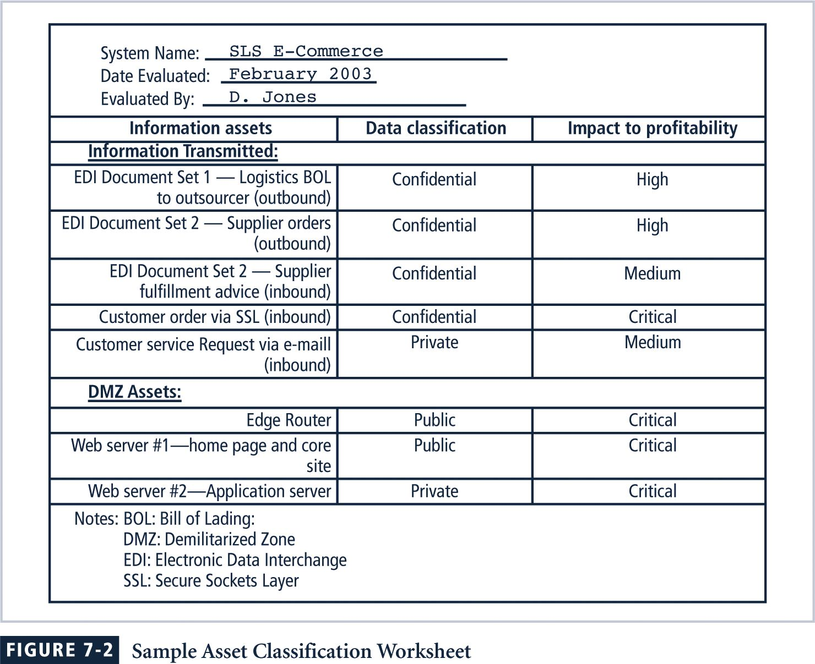
Sample Asset Classification Worksheet

Slide 9
Risk Assessment
Threat Agent and Threat | Targeted Asset | Threat Level | Risk (Scale of 1-5)
Steal company information to sell | Org. data | High | 3
Fire | Org. Facility, Equipment | Critical | 4
Hacking | Org Hardware/Software | Low | 1
Risk assessment:
  Identify threats
  Prioritize threats
  Assess vulnerabilities in current InfoSec plan
  Determine risk of each threat
  R = P * V – M + U
  R = Risk
  P = Probability of threat attack
  V = Value of Information Asset
  M = Mitigation by current controls
  U = Uncertainty of vulnerability

Slide 10
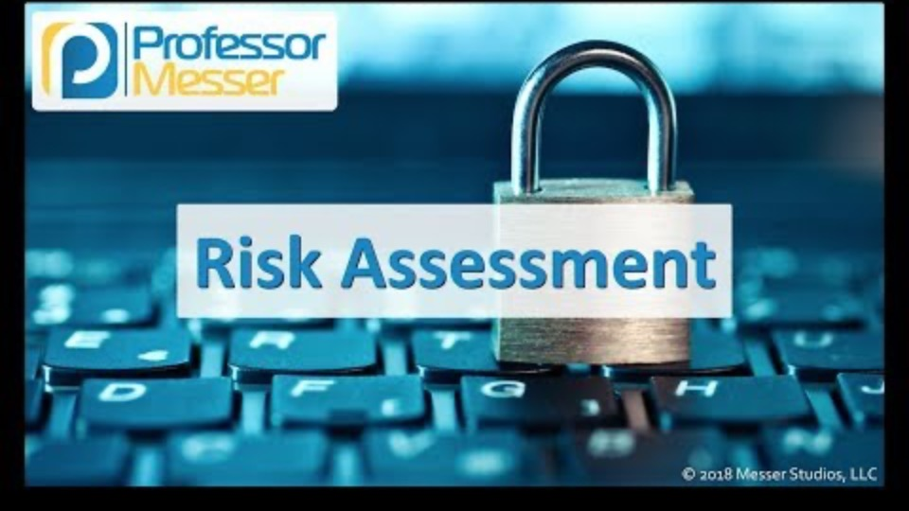
Risk Assessment

Slide 11
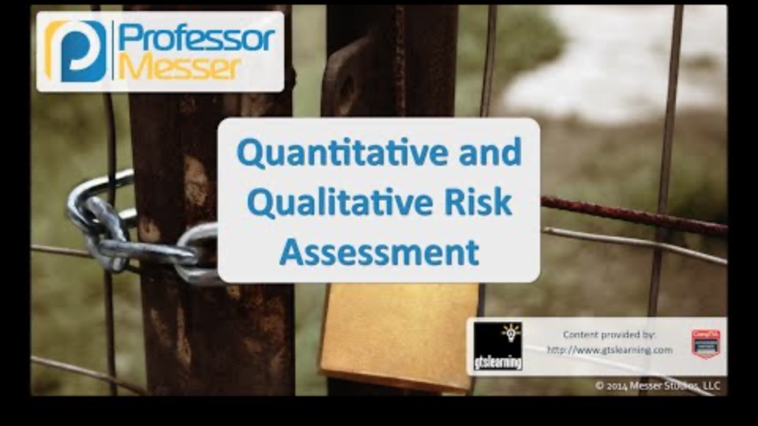
Quantitative and Qualitative Risk Assessment

Slide 12
Risk control
The steps to risk control are:
Cost-Benefit Analysis (CBA)
  Single Loss Expectancy (SLE)
  Annualized Rate of Occurrence (ARO)
  Annual Loss Expectancy (ALE)
  Annual Cost of the Safeguard (ASG)
Feasibility Analysis
  Organizational Feasibility
  Operational Feasibility
  Technical Feasibility
  Political Feasibility
Risk Control Strategy Implementation

Slide 13
Cost-Benefit analysis
Some common formulas used to calculate cost-benefit analysis
SLE = AV * EF
  AV = Asset Value, EF = Exposure factor (% of asset affected)
ALE = SLE * ARO
CBA = ALE (pre-control) – ALE (post-control) – ACE

Slide 14
Feasibility analysis
Organizational: Does the plan correspond to the organization’s objectives? Does it limit the organization’s capabilities in any way?
Operational: Will shareholders (users, managers, etc.) be able/willing to accept the plan? Is the system compatible with the new changes?
Technical: Is the necessary technology owned or obtainable? Are our employees trained and if not can we afford to train them?
Political: Is the budget required justifiable?

Slide 15
Risk control Strategies
Defense
Transferal
Mitigation
Acceptance (Abandonment)
Termination

Slide 16
Risk control Strategy: defense
Defense: Prevent the exploitation of the system via application of policy, training/education, and technology.
Preferably layered security (defense in depth)
  Counter threats
  Remove vulnerabilities from assess
  Limit access to assets
  Add protective safeguards

Slide 17
Risk control Strategy: transferal
Transferal: Shift risks to other areas or outside entities to handle
Can include:
  Purchasing insurance
  Outsourcing to other organizations
  Revising deployment models

Slide 18
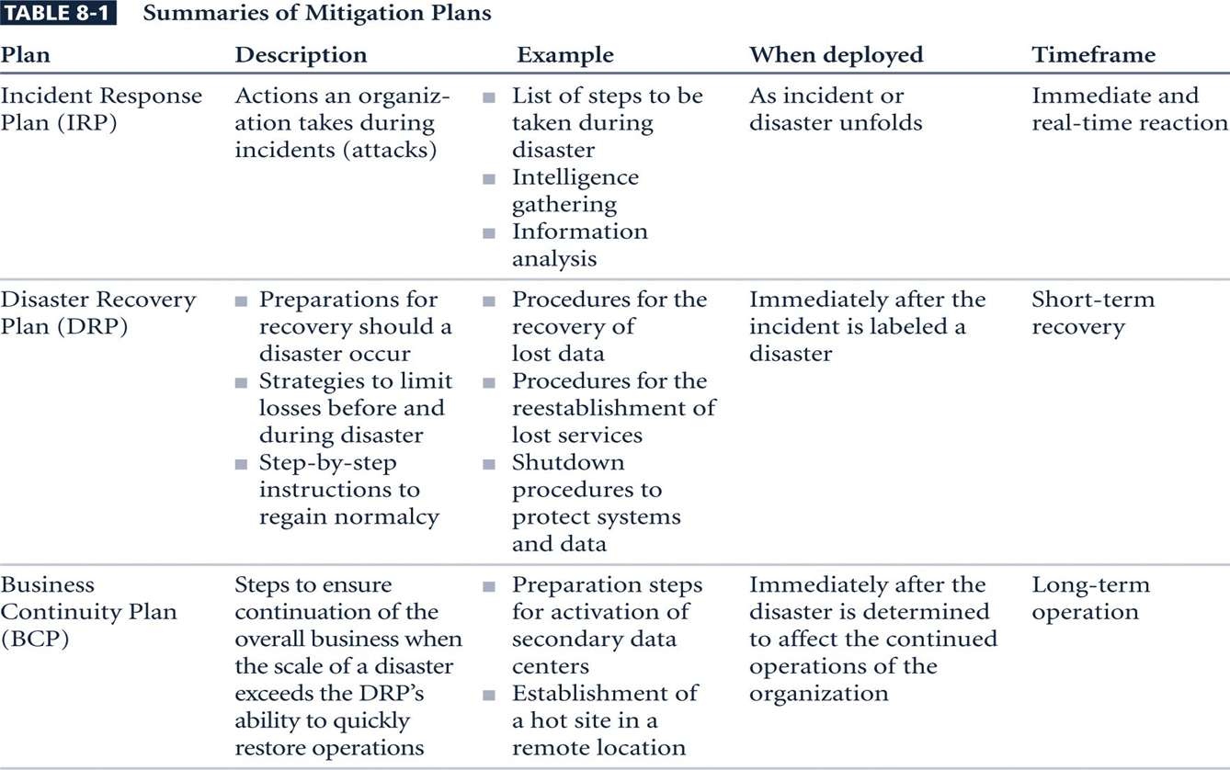
Risk control Strategy: Mitigation
Mitigation: Creating plans and preparations to reduce the damage of threat actualization
Preparation should include a:
  Incidence Response Plan
  Disaster Recovery Plan
  Business Continuity Plan

Slide 19
Risk control Strategy: Acceptance
Acceptance: Properly identifying and acknowledging risks, and choosing to not control them
Appropriate when:
  The cost to protect an asset or assets exceeds the cost to replace it/them
  When the probability of risk is very low and the asset is of low priority
  Otherwise acceptance = negligence

Slide 20
Risk control Strategy: Termination
Termination: Removing or discontinuing the information asset from the organization
Examples include:
  Equipment disposal
  Discontinuing a provided service
  Firing an employee

Slide 21
Pros and cons of each strategy
Pros
Cons
Defense: Preferred all round approach
Transferal: Easy and effective
Mitigation: Effective when all else fails
Acceptance: Cheap and easy
Termination: Relatively cheap and safe
Defense: Expensive and laborious
Transferal: Dependence on external entities
Mitigation: Guarantees company loss
Acceptance: Rarely appropriate, unsafe
Termination: Rarely appropriate, requires company loss

Slide 22
Standard approaches to risk management
U.S CERT’s Operationally Critical Threat Assessment Vulnerability Evaluation (OCTAVE) Methods (Original, OCTAVE-S, OCTAVE-Allegro)
NIST Risk Management Model
Microsoft Risk Management Approach
Jack A. Jones’ Factor Analysis of Information Risk (FAIR)
Delphi Technique

Slide 23
Sources
M. Whitman, H. Mattford. , Management of information security, Fourth Edition, Stamford, CT: Cengage Learning, 2014, p. 279-313.
www.duckduckgo.com

